Slide 1
Ants Vocabulary Slides

Slide 2
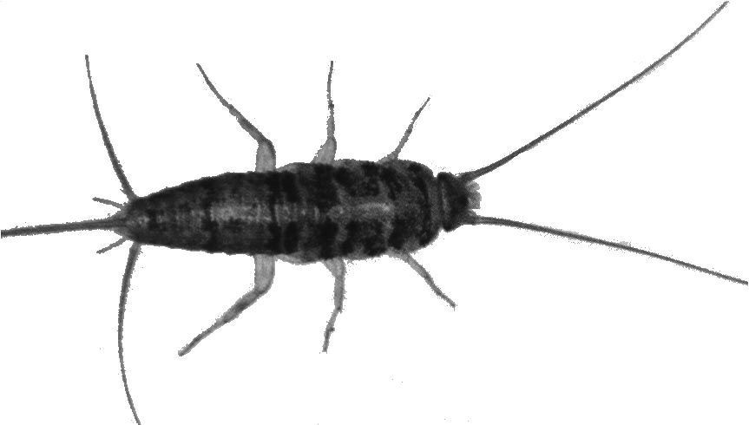
Antennae
Antennae help insects feel and smell. They are like long noses and fingers.

Slide 3
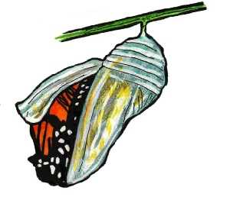
cocoon
An insect will change shape in a cocoon. A cocoon will protect the insect while it changes.

Slide 4
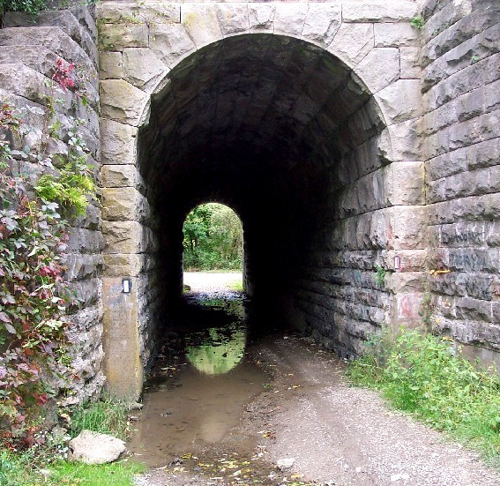
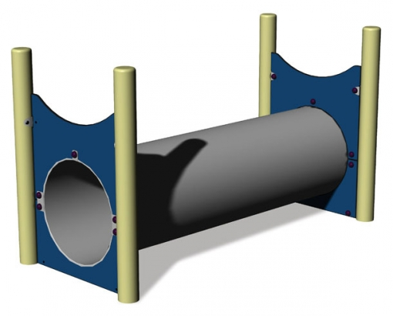
tunnel
A tunnel is a hole in the earth or underwater that goes from one side to the other.

Slide 5
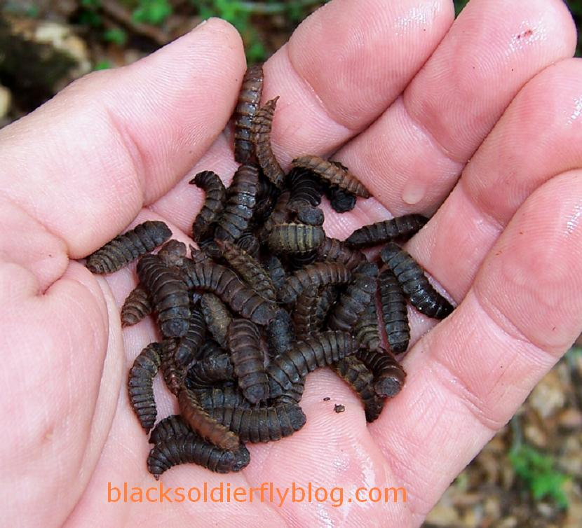
larvae
Larvae are insect babies. They usually look like little worms.

Slide 6
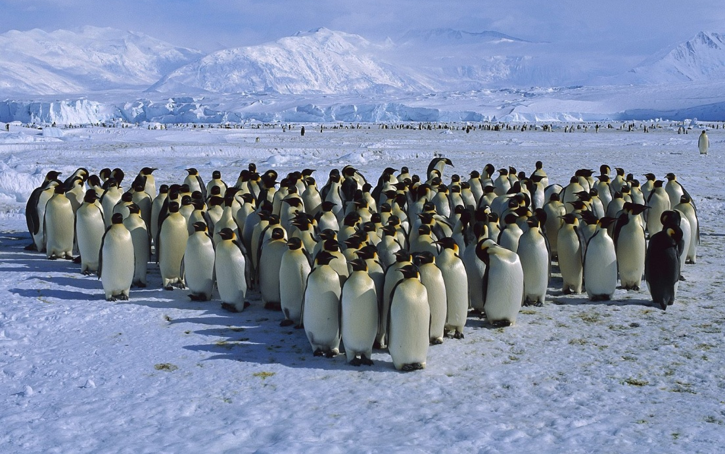
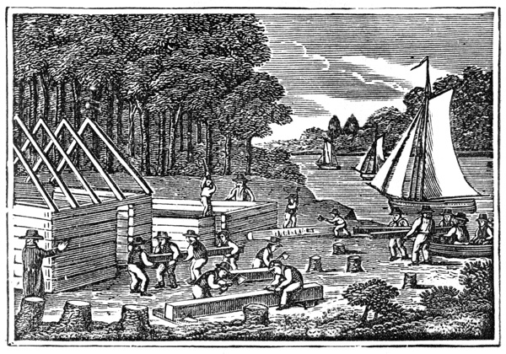
colony
A colony is a group of people or animals that live together.

Slide 7
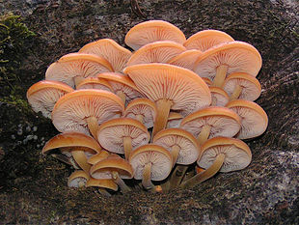
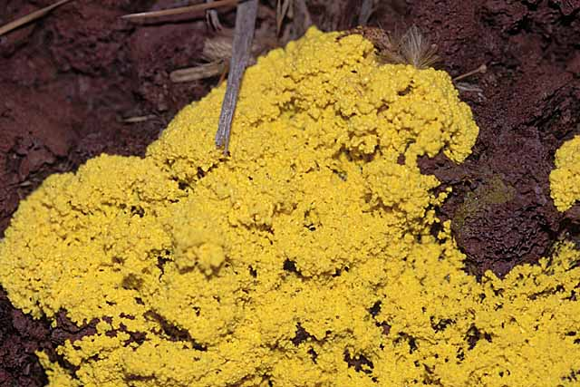
fungus
A fungus is a group of living things (not a plant or animal) that live off of the living things around them.

Slide 8
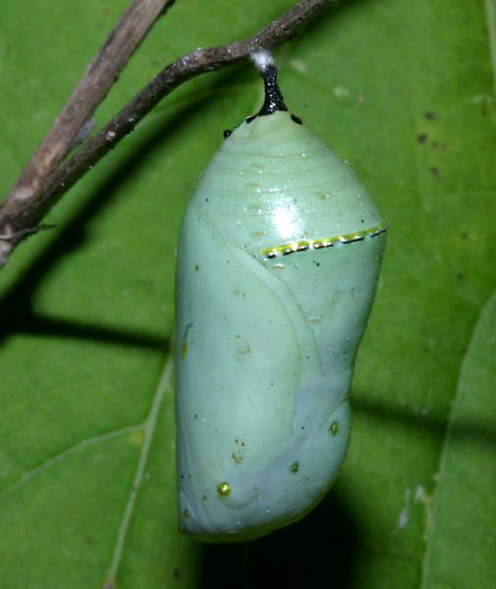
Which vocabulary word best describes the picture?

Slide 9
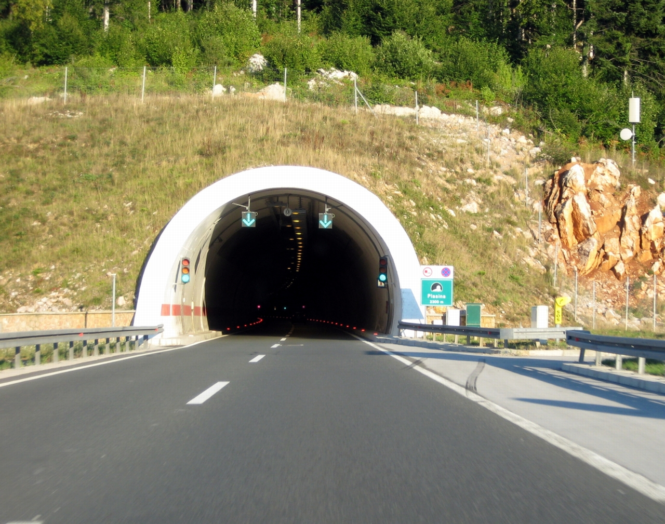
Which vocabulary word best describes the picture?

Slide 10
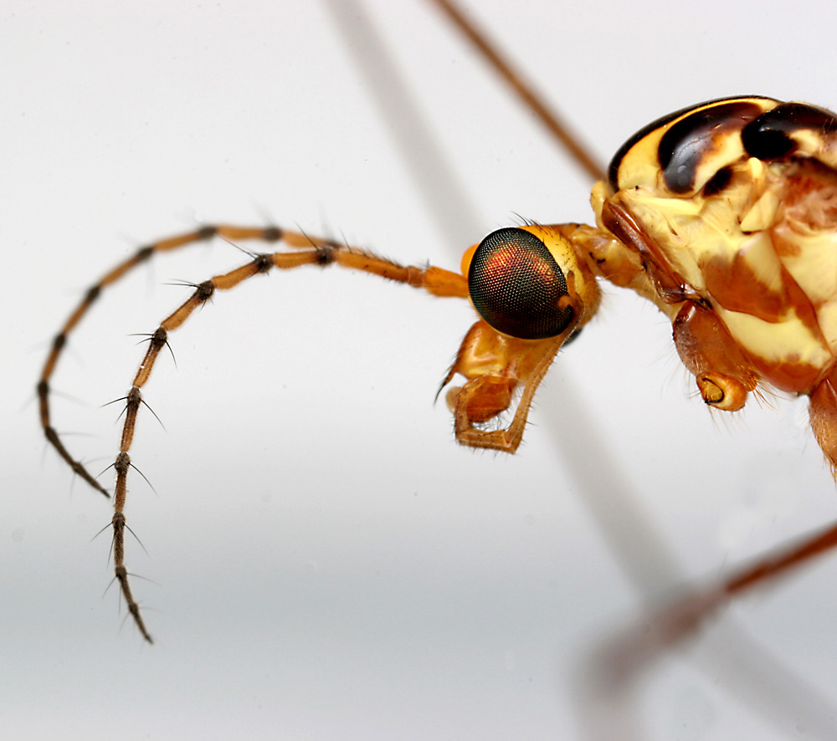
Which vocabulary word best describes the picture?

Slide 11
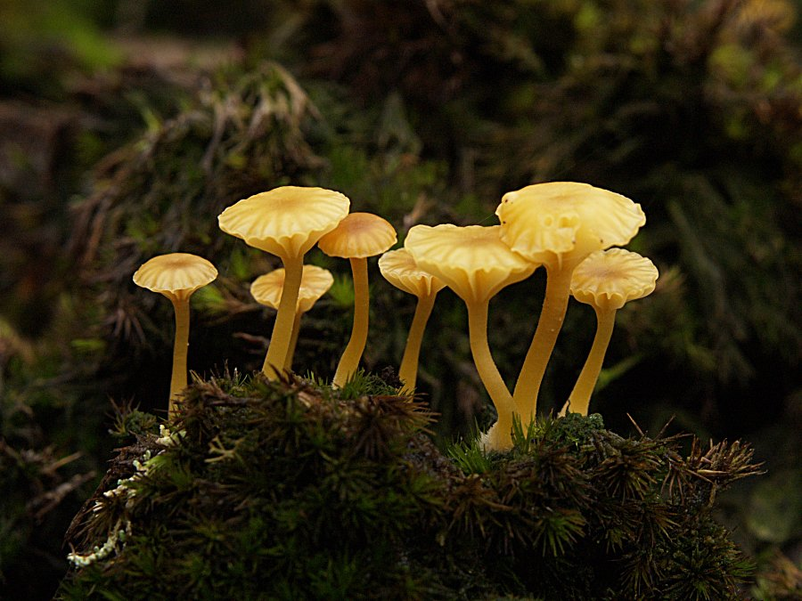
Which vocabulary word best describes the picture?

Slide 12
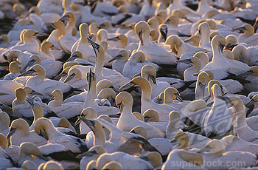
Which vocabulary word best describes the picture?

Slide 13
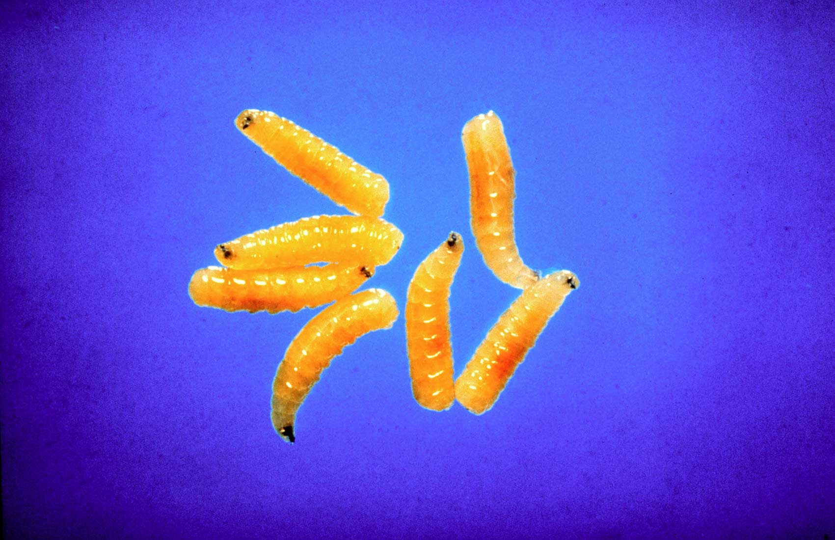
Which vocabulary word best describes the picture?

